Slide 1
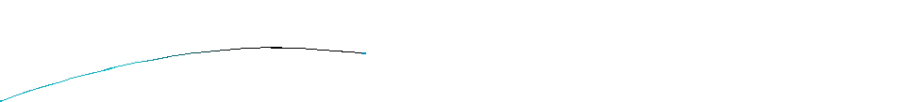


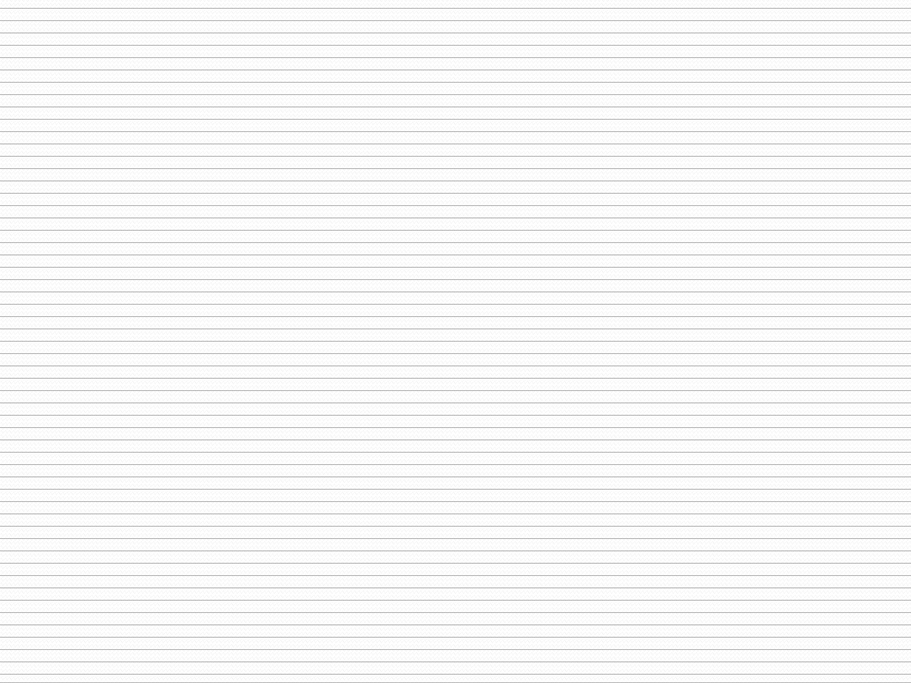
Chapter 9
User defined Function
Asharfi Akram
Lecturer,ICE

Slide 2
Function:
A function is a group of statements that together perform a task. Every C program has at least one function, which is main(), A large program in c can be divided to many subprogram. The subprogram posses a self contain components and have well define purpose. The subprogram is called as a function. Defining a Function:
The general form of a function definition in C
programming language is as follows:
return_type function_name( parameter
{
body of the function
}
list )

Slide 3
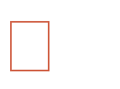
Types of Functions
Library (Built In) Functions:
○ They are written in the header files.
○ To use them appropriate header files should be included.
Header Files Functions Defined
stdio.h Printf(), scanf(), getchar(), putchar(),
gets(), puts(), fopen(), fclose()
conio.h Clrscr(), getch()
Ctype.h Toupper(), tolower(), isalpha()
Math.h Pow(), sqrt(), cos(), log()
Stdlib.h Rand(), exit()
String.h Strlen(), strcpy(), strupr()

Slide 4
User Defined Functions
○ Written by the user at the time of programming
Example
int EEE(float mark);
Advantages of Function
It is much easier to write a structured program where a large program can be divided into a smaller, simpler task.
Allowing the code to be called many times
Easier to read and update
It is easier to debug a structured program where there error is easy to find and fix
Functions can be used by other program’s

Slide 5
Elements of User defined functions
Function Prototype
Function Call
Function arguments and parameters
Function Definitions

Slide 6


Function Return
Types
Can be any of C’s
char
int
float
long………
data type:
Examples:
int func1(...)
float func2(...)
void func3(...)
/* Returns a type int.
*/
/* Returns a type float. */
/* Returns nothing.
*/

Slide 7
Function Prototype:
It specify the type of value that is to be return from the function and that is to be passed to the function.
It is defined in the beginning before the function call is made.
Syntax:
○ return-type name-of-function(list of arguments);
○ Example
Void sum(int, int);

Slide 8
Function Call
A function can be called by specifying name and list
of arguments enclosed in parenthesis and separated
by comma.
If there is no arguments empty parenthesis are place
after function name.
If function return a value, function call is written as
assignment statement as:

Slide 9
Function calling:
#include <stdio.h>
int show ( )
{
printf(“It’s a function”);
}
int main ( )
{
show ();
}
function call

Slide 10
Function arguments and parameters
Arguments are also called actual parameters.
Arguments are written within parenthesis at the time
of function call.
Parameters are also called formal parameters.
These are written within parenthesis at the time of
function definition.

Slide 11

Example of
main () {
Parameter and Argument:
//Argument
add (10, 20),
}
// Parameter
add (int i, int
int j;
j=i+j;
}
j) {

Slide 12
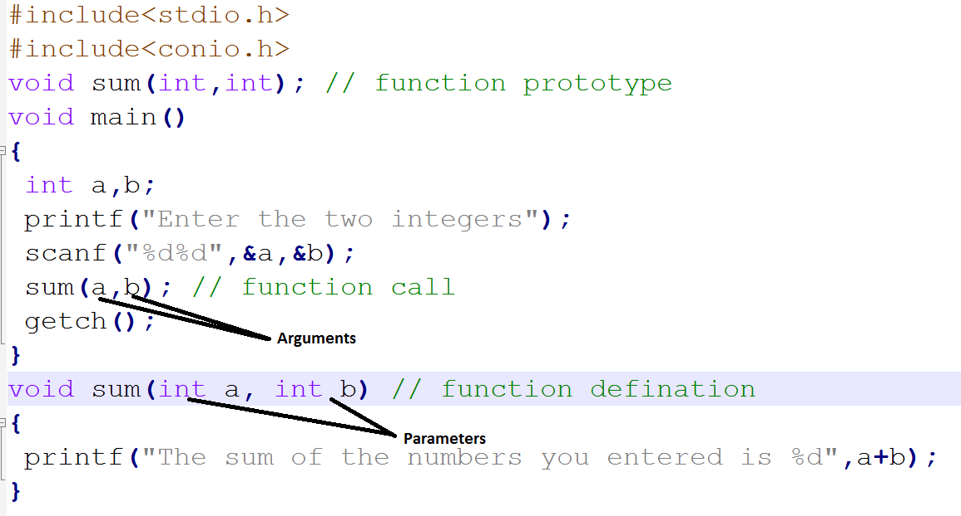
Examples

Slide 13
Actual and Formal
#include <stdio.h>
void main(void)
{
void test_function(int) ;
parameter:
test_function(1) ; \\ actual parameter
}
Void test_function(i_recd_value) \\formal parameter
int i_recd_value ;
{
cout << "Value passed = " << i_recd_value ;
return ;
}

Slide 14
Function Return Statement
It is the last statement of the function that return
certain values.
It return certain types of values to the place from
where the function was invoked.
Syntax:
return(variable-name or constant);

Slide 15
Categories of function
Function with no arguments and no return
Function with arguments but no return
Function with no arguments and return
Function with arguments and return

Slide 16
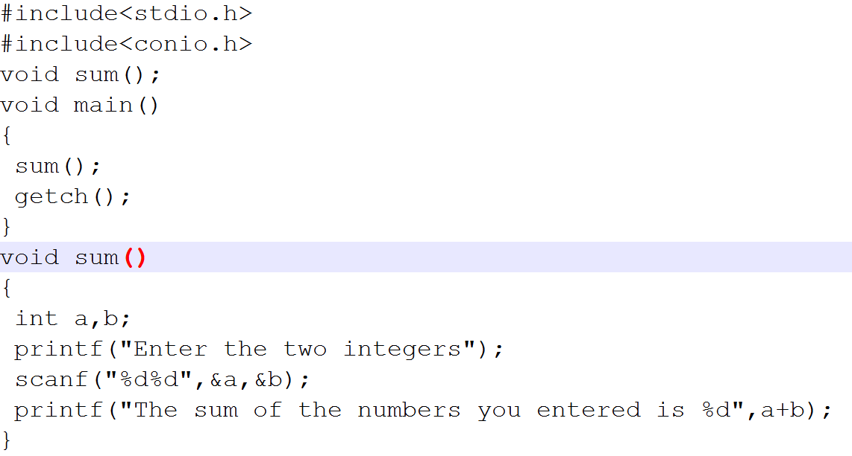
Function with no argument and no return

Slide 17
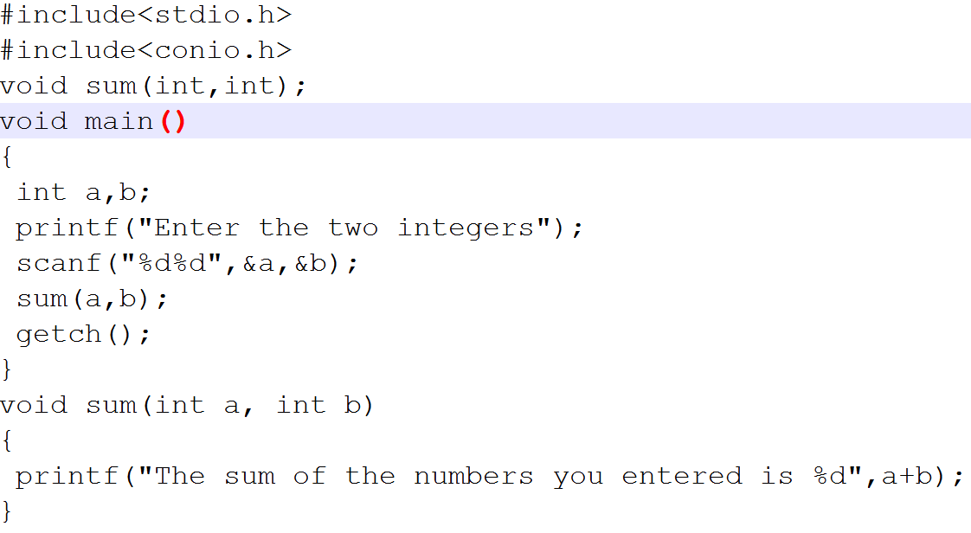
Function with argument and no return

Slide 18
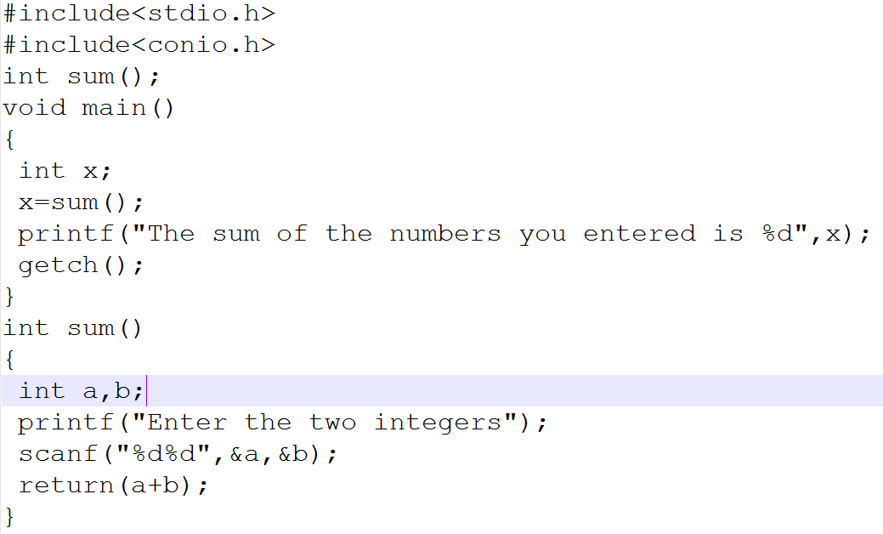
Function with no argument and return

Slide 19
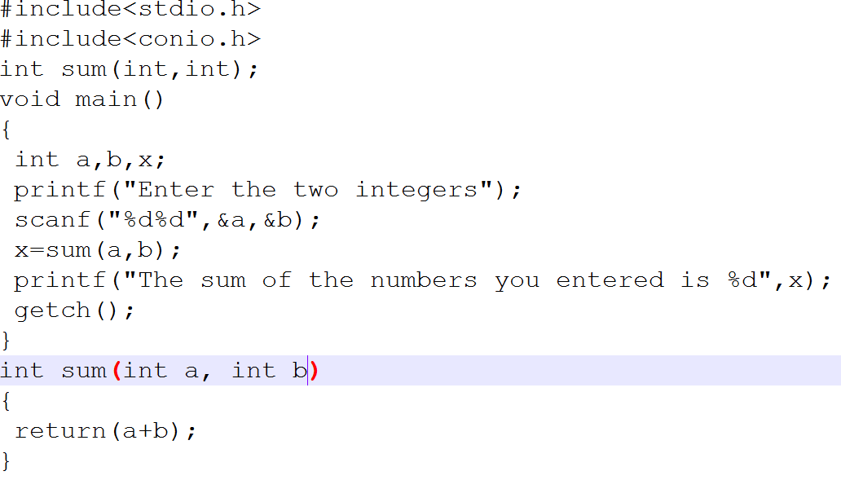
Function with argument and return

Slide 20
Local Variables:
Variables that are declared inside a function or block are called local variables. They can be used only by statements that are inside that function or block of code. Local variables are not known to functions outside their own. Following is the example using local variables. Here all the variables a, b and c are local to main() function.

Slide 21
Global Variables:
Global variables are defined outside of a function,
usually on top of the program. The global variables will
hold their value throughout the lifetime of your
program and they can be accessed inside any of the
functions defined for the program.
A global variable can be accessed by any function. That is, a global variable is available for use throughout your entire program after its declaration. Following is the example using global and local variables:

Slide 22
Local variable and Actual variable:
#include
<stdio.h>
void
show
(){
int
i=5;
//local
variable
Printf(“%d\n”,i);
}
int
int
main
i=2;
()
{
//Actual
variable
Printf(“%d\n”,i);
show
();
}

Slide 23
Methods of calling function
Call by value
Call by reference

Slide 24
Call by Value:
Call by Value, means that a copy of the data is made
and stored by way of the name of the parameter.
Any changes to the parameter have NO affect on
data in the calling function.

Slide 25
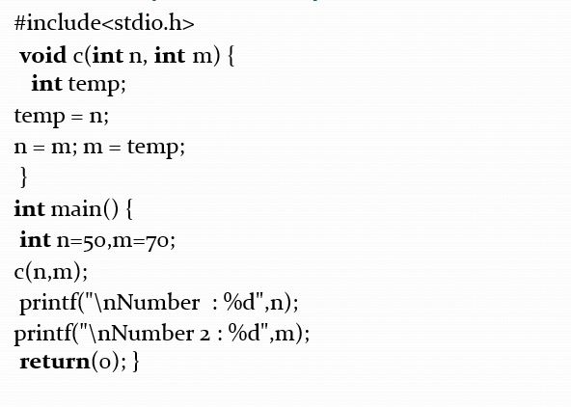
Example
Call
by
value:

Slide 26
Call by Reference:
Reference(address) of the original variable is passed.
Function does not create its own copy, it refers to the original values by reference.
Functions works with the original data and changes are made in the original data.

Slide 27
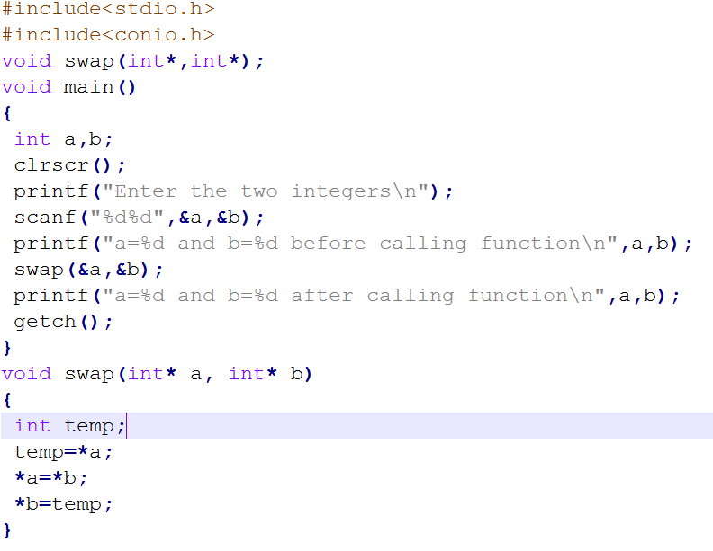

Slide 28
Array of function:
#include <stdio.h>
float average(float a[]);
int main(){
float avg, c[]={23.4, 55, 22.6, 3, 40.5,
printf("Average age=%.2f",avg);
return 0; }
float average(float a[]){
int i;
float avg, sum=0.0;
18};
avg=average(c);
}
for(i=0;i<6;++i){ sum+=a[i];
avg =(sum/6);
return avg;
}

Slide 29
Recursion:
Recursion defines a function in terms of itself.
It is a programming technique in which a function calls itself. A recursive function calls itself repeatedly, with different argument values each time.
Some argument values cause the recursive method
return without calling itself. This is the base case.
to
Either omitting the base case or writing the recursion
step
incorrectly
will
cause
infinite
recursion
(stack
overflow error).

Slide 30
Example:
#include <stdio.h>
int sum(int n);
int main(){
int num,add;
printf("Enter a positive integer:\n");
scanf("%d",&num);
add=sum(num);
printf("sum=%d",add);
}
int sum(int n){
if(n==0)
return n;
else
return n+sum(n-1);
/*self call to function sum() */
}

